Slide 1
Designing of Green-House Environment
Exploring near-optimal and Diverse set of Pareto Front Solutions

Slide 2
Content
Components
Objectives
Environment and Agents
Reward System
Q-Learning
Single Objective and Multi Objective RL
Multiagent Multi Objective RL
Different Q-Tables
Shared Q-Tables
Pareto Front
Problems
Next Steps

Slide 3
Components
Heater
Water Tank
Pack Soil
Heat Sensor
Camera
Fan
LED
Water Pump
PCB
Pipes

Slide 4
Objectives
Minimize distance between pack soil, water tank and water pump.
Minimize distance between heater and the fan.
Maximize distance between LED and heat sensor
Maximize distance between heater and heat sensor
Maximize lighting of pack soil by the LED
Maximize view of pack soil captured by the camera

Slide 5
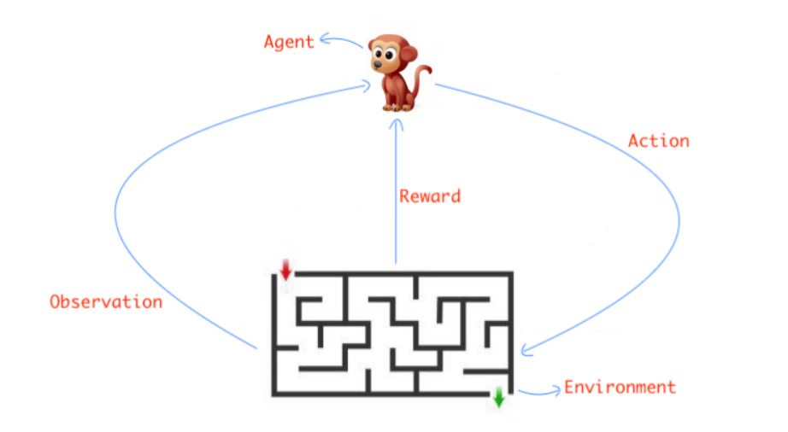
Environment and Agents

Slide 6
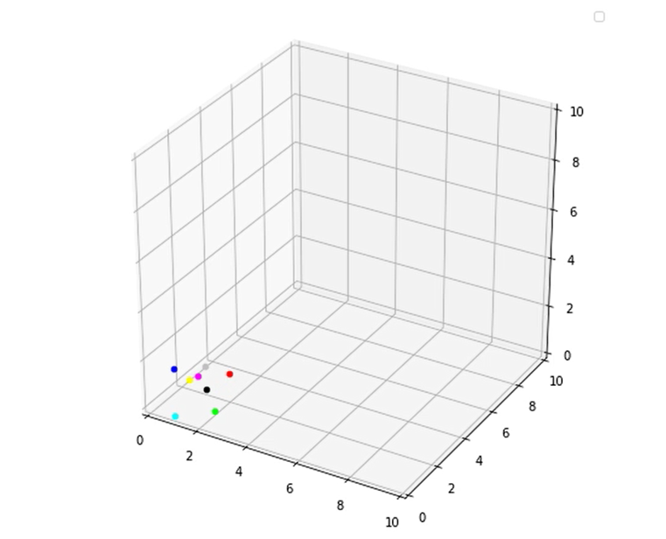
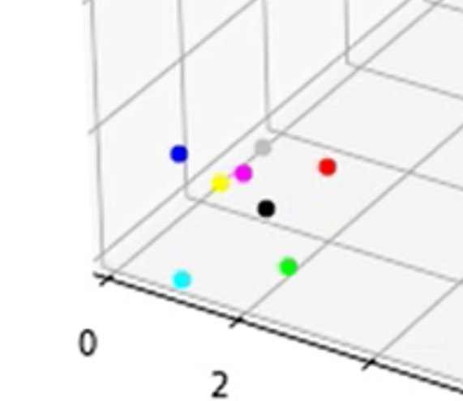
Environment and Agents (cont.)

Slide 7
Reward System
Reward Value | Reward Info
-1 | Move Away from the objective
0.5 | Maintain the same distance
2 | Move Closer to the objective
5 | Move Closer and find a similar best score
10 | Move Closer and find a new best score

Slide 8
Thank You 2

